Slide 1
Kake:s Pitch
Case: Arbetsförmedlingen

Slide 2
Case
Get around disabilities in the employment process

Slide 3
What's important in the employment process?
The skills you as an employer actually want to utilize!

Slide 4
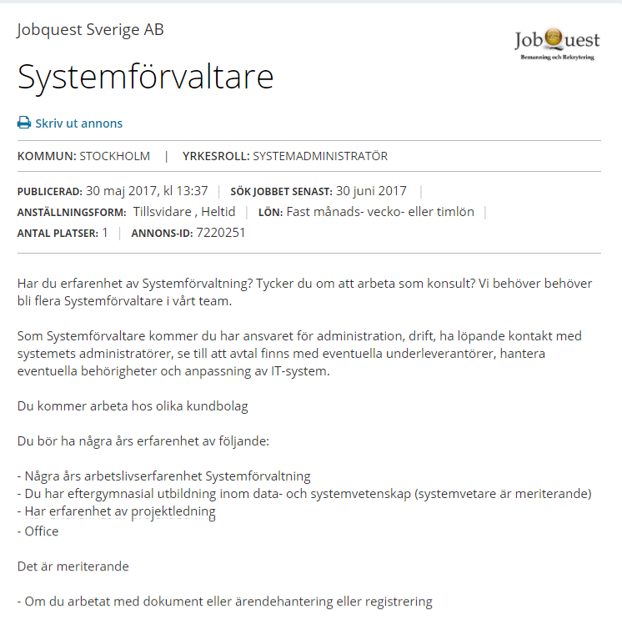
Today?

Slide 5
Our solution
Make the employer concretize the skills they want to utilize

Slide 6
Examples
Work title: | Skills:
Programmer: | Java, HTML, C++
Press secretary: | Good social media score (KLOUT), good journalist contacts, ability to pitch a story/angel
Truck driver: | Work alone, drive a truck, have some customer contact.

Slide 7
Get around disabilities how?
Turn disabilities to skills!

Slide 8
Examples
Disability: | Skills / Personality traits:
Dyslexia | Ability to see connections and understand structure
Autism | Attention to details
Social phobia | Ability to work alone and be Self-directed?

Slide 9
Interest for the employer?
Have full control over the hiring process
Save money in the employment process
Get the right person you might have overlooked

Slide 10
Interest for the employee
Get hired on concrete skills – No roadblocks!

Slide 11
Page →
The portal?
Applicant | Employer
- How does it work?
Feed in →
Applicant:
Skills I have
Employer:
Skills I want
Get out →
Matching jobs
Matching Applicants

Slide 12
The whole process?
Instead of CV → Skills → Matches
Case ← Send out to your matches
Drive / Values
Personality test ← Will the person fit in the team? (DISC analysis?)
interview? ← The first place you actually see the person

Slide 13
Sum up
Turn disabilities in to skills!
Get around roadblocks like diplomas and past Employments!
Get a affordable employment process that actually focus on the employees skills and abilities!

